Slide 1
Figures
Cardiomyopathy SLR

Slide 2
Identification of studies via databases
21 studies reported:
Only a single gene
CNVs only
Genes associated with Noonan Syndrome or Amyloidosis
Genes not typically associated with the phenotype
Did not distinguish P, LP from VUS
Cascade testing only
Records identified from:
Pubmed (n = 6644 )
Biomed Explorer (n = 250)
Records removed before screening:
Duplicate records removed (n = 219 )
Identification
Records screened for genetic testing in Cardiovascular Disease
(n = 6675)
Records excluded
(n = 5829)
Screened for study type and clinical population
(n = 846 )
Excluded
(n = 359)
Screening
Abstracts assessed for eligibility
(n = 489)
Non-cardiomyopathy (n = 388)
66 studies included in the quantitative meta-analysis
Full text assessed for eligibility
(n = 101)
Lack of required detail for endpoints (n = 14)
Studies included in review
(n = 87)
Included
Figure 1. PRISMA flow diagram
Notes:
Consider, if feasible to do so, reporting the number of records identified from each database or register searched (rather than the total number across all databases/registers).
**If automation tools were used, indicate how many records were excluded by a human and how many were excluded by automation tools.
From: Page MJ, McKenzie JE, Bossuyt PM, Boutron I, Hoffmann TC, Mulrow CD, et al. The PRISMA 2020 statement: an updated guideline for reporting systematic reviews. BMJ 2021;372:n71. doi: 10.1136/bmj.n71. For more information, visit: http://www.prisma-statement.org/

Slide 3
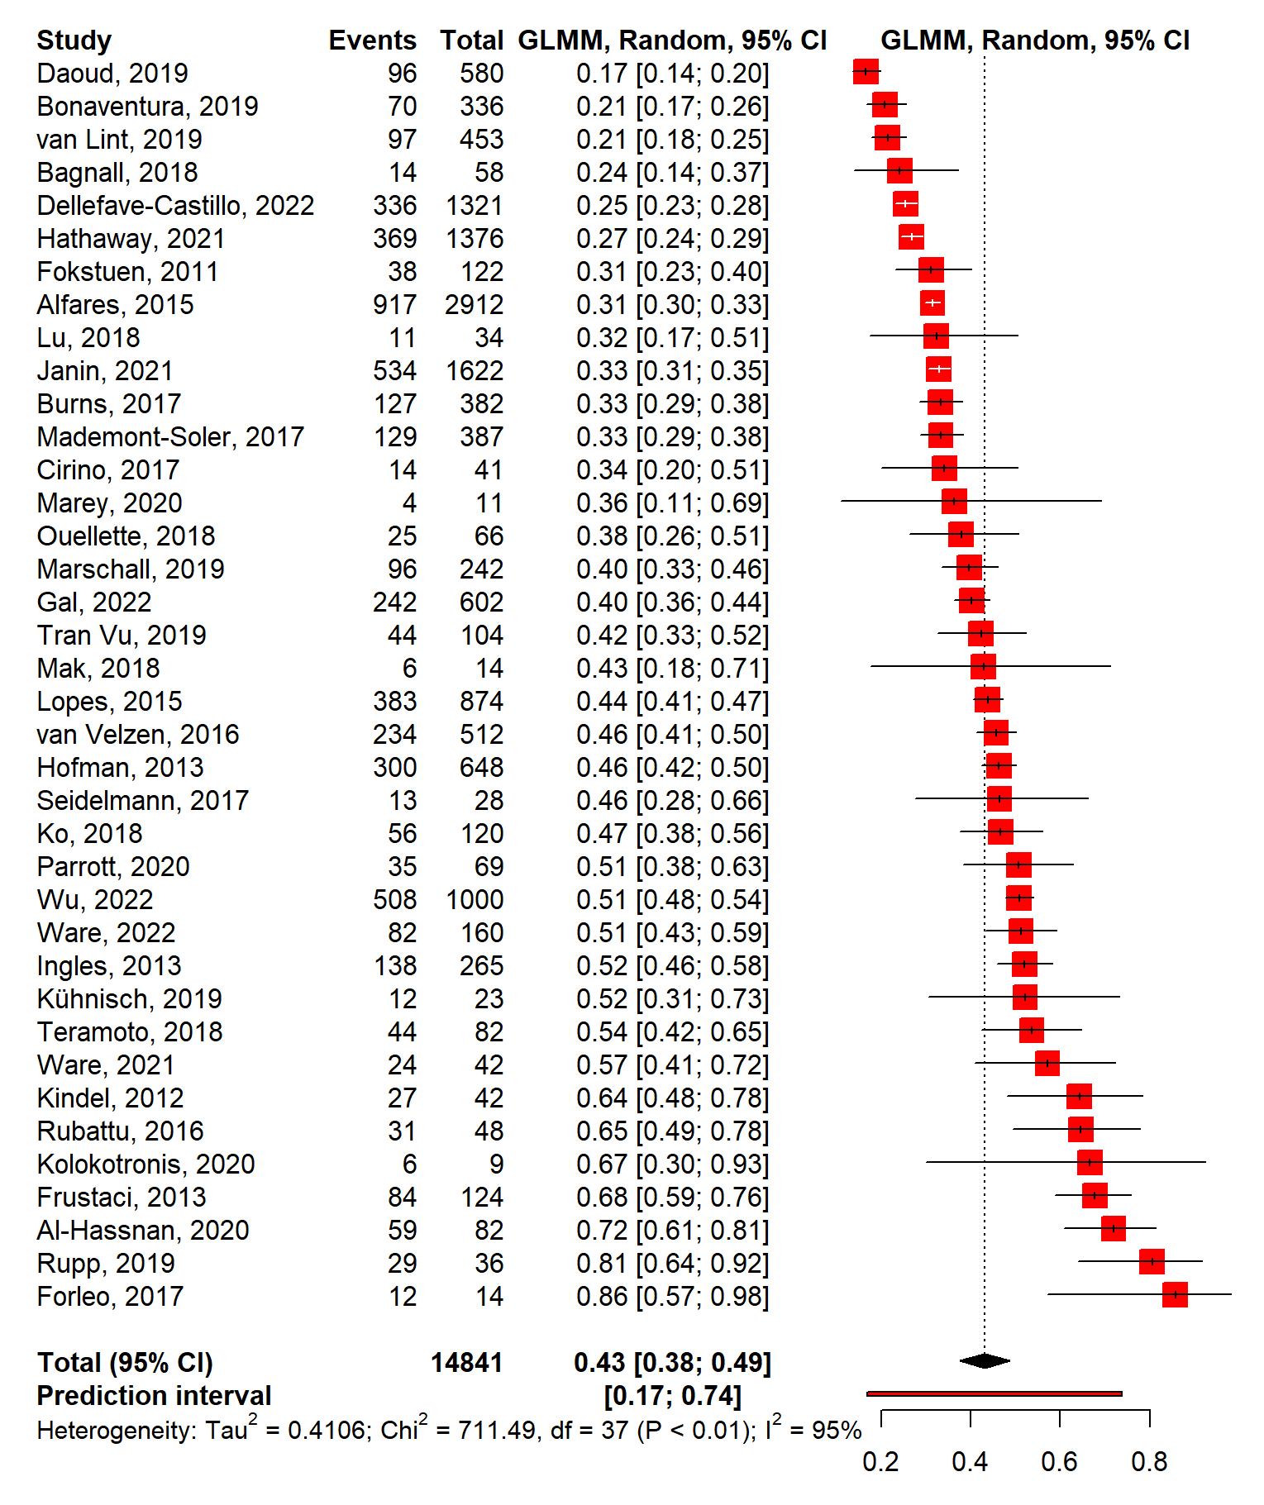
Disease | Studies | Probands | mean_DY | min | max | Clinical_Utility | % Cases VUS
HCM | 19 | 9381 | 0.4333 | 0.2083 | 0.8056 | 10 | 0.1589
Mixed | 19 | 5460 | 0.4621 | 0.1655 | 0.8571 | 3 | 0.4869
Total | 38 | 14841 | 0.4477 | 0.1655 | 0.8571 | 13 | 0.3414
Table 1. HCM Study Summaries
Figure 2. HCM Diagnostic Yields (N=36)

Slide 4
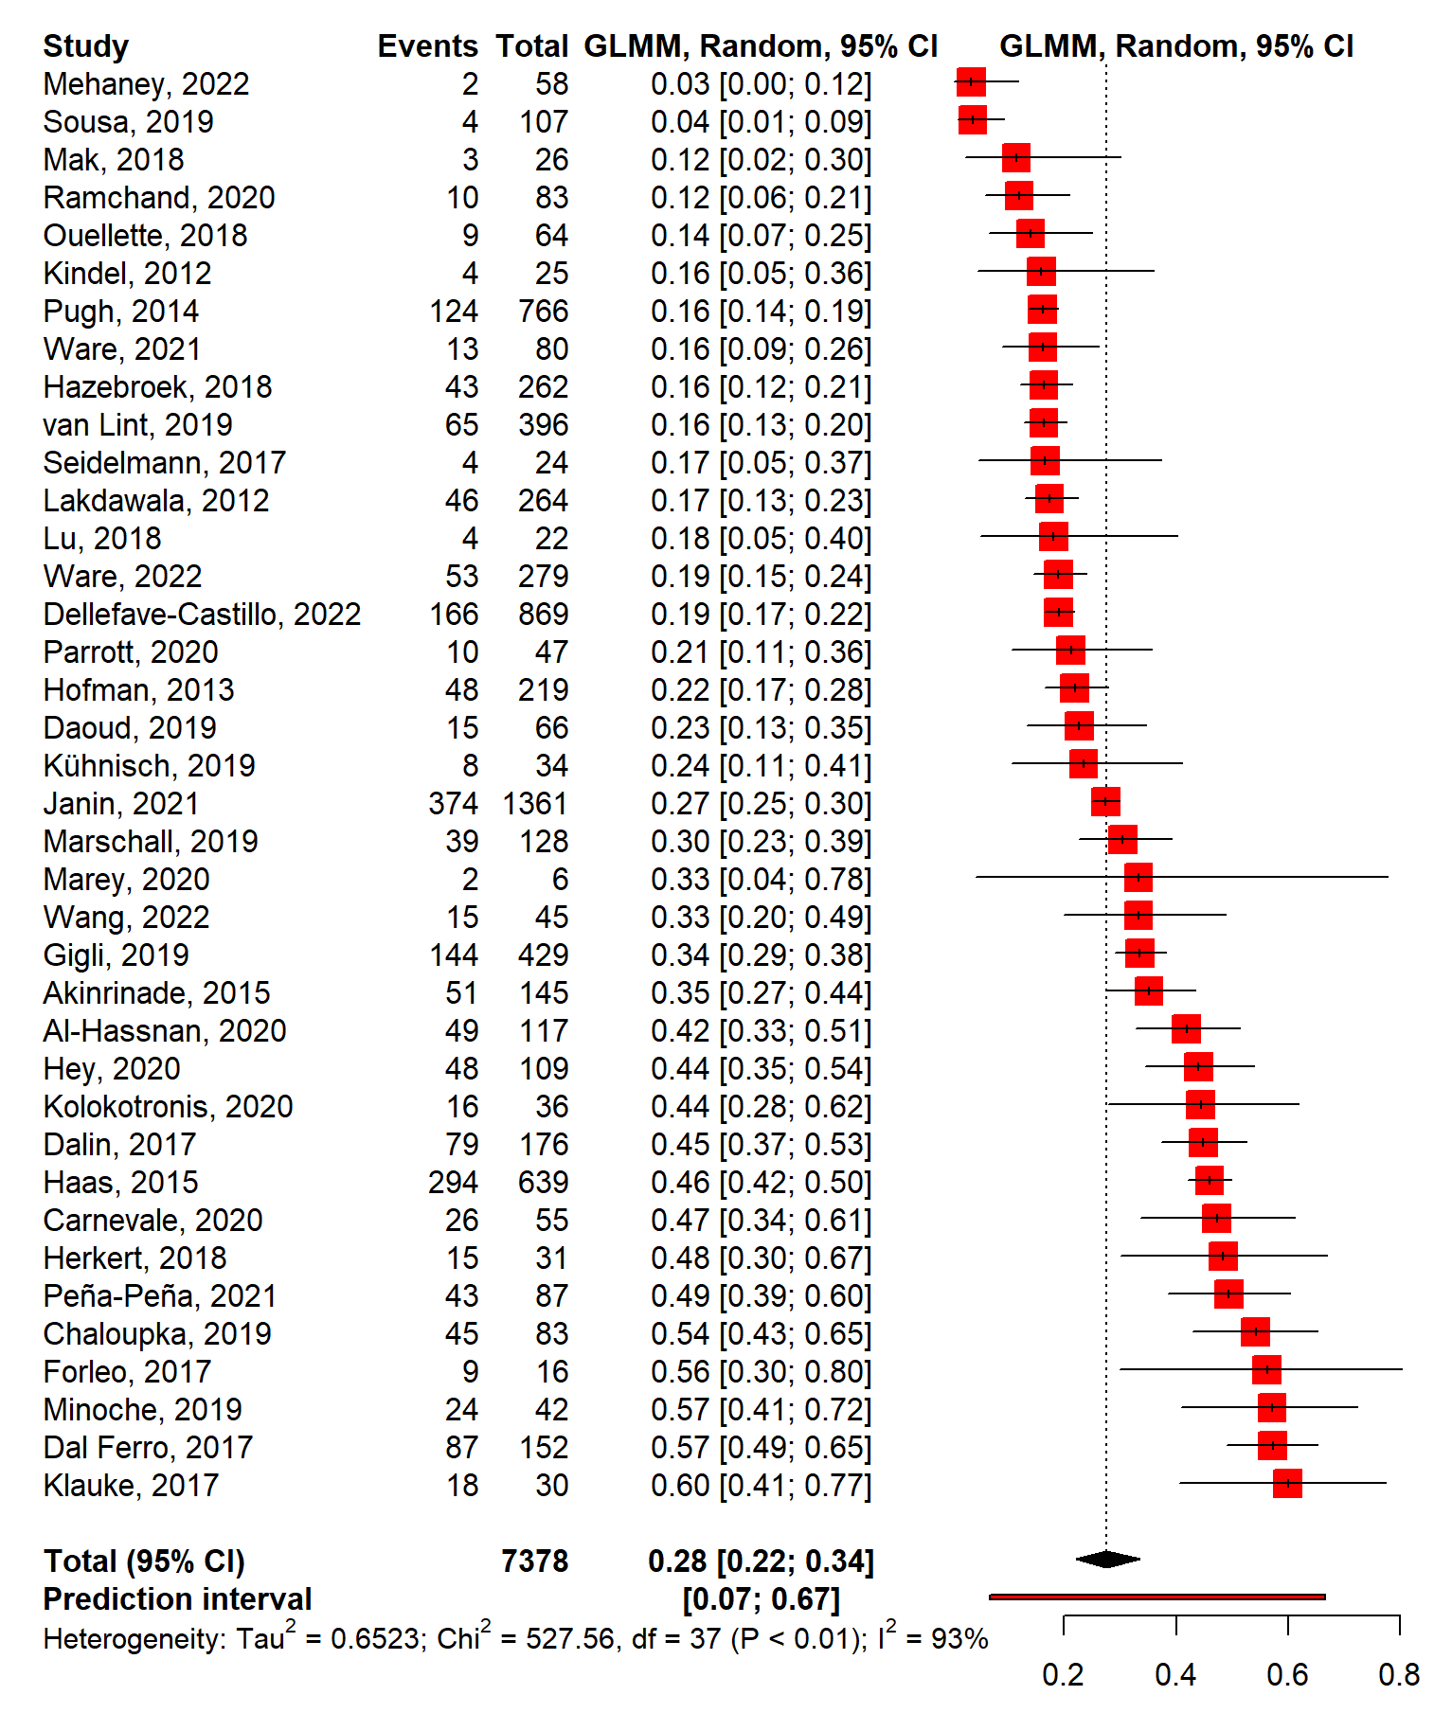
Disease | Studies | Probands | mean_DY | min | max | Clinical_Utility | % Cases VUS
DCM | 17 | 3475 | 0.3626 | 0.0374 | 0.5724 | 8 | 0.4215
Mixed | 21 | 3903 | 0.2543 | 0.0345 | 0.6 | 3 | 0.483
Total | 38 | 7378 | 0.3028 | 0.0345 | 0.6 | 11 | 0.467
Table 2. DCM Study Summaries
Figure 3. DCM Diagnostic Yields (N=37)

Slide 5
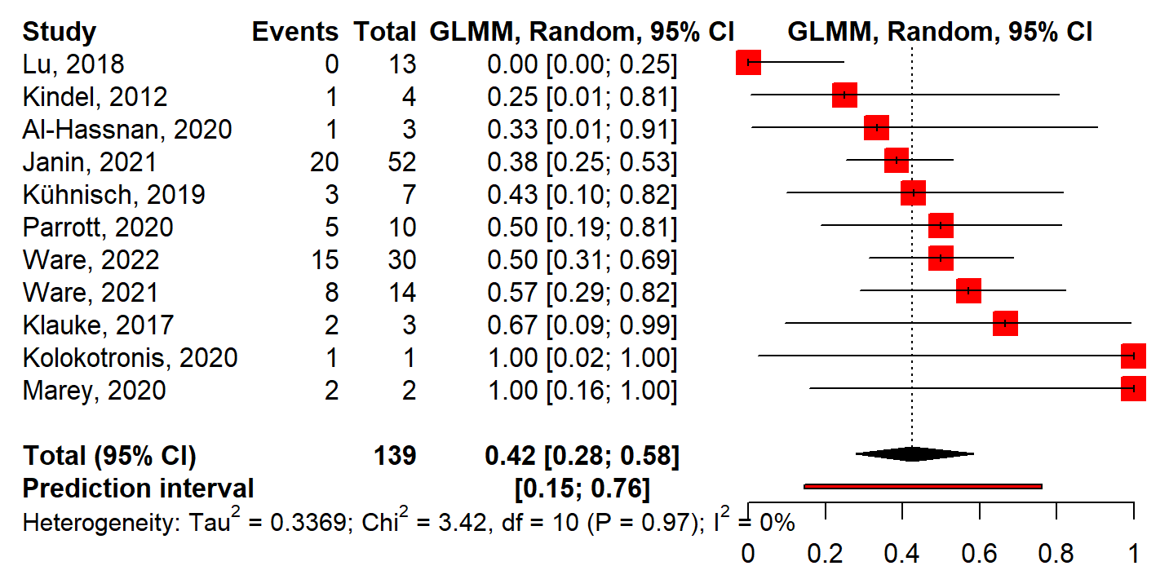
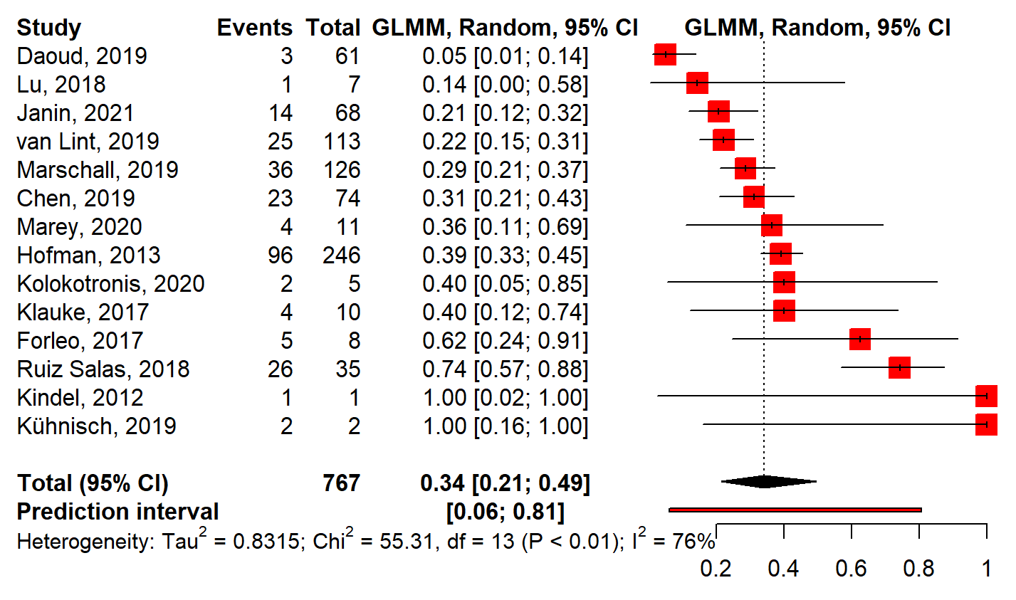
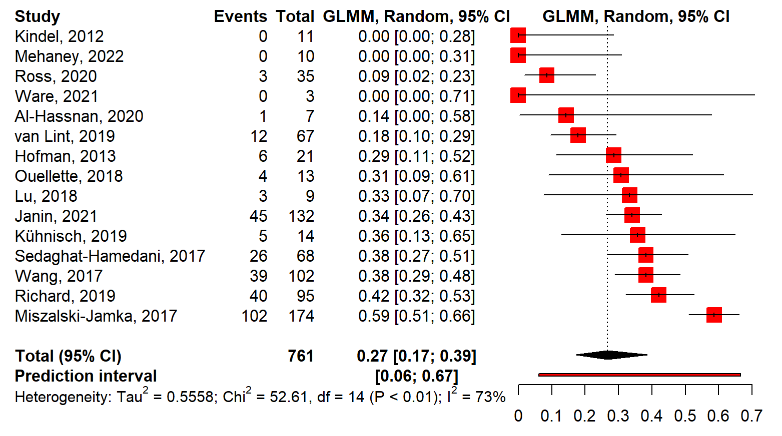
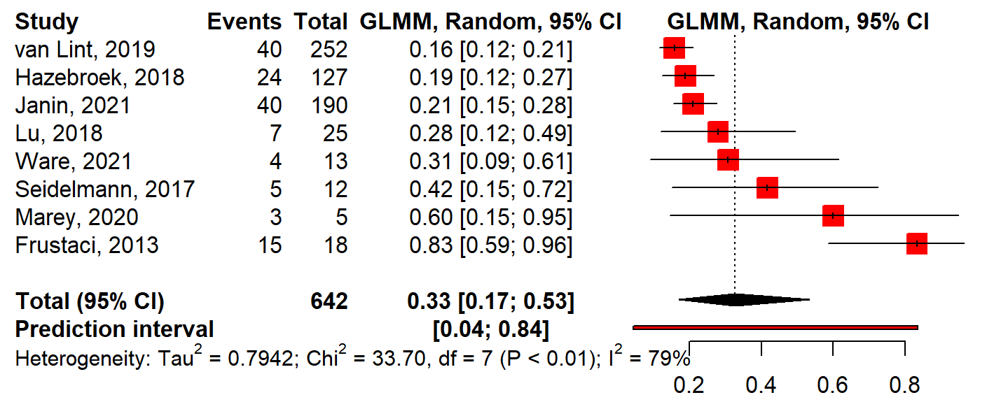
A
B
RCM
ACM
C
D
Other CM
LVNC
Figure 4. Diagnostic yields of other cardiomyopathies. RCM – restrictive cardiomyopathy; ACM – arrhythmogenic cardiomyopathy; LVNC – left ventricular non-compaction; Other CM – unclassified or mixed cardiomyopathy

Slide 6



Year
Lab Location
Variant of Uncertain Significance
[Cost]
Variant Interpretation & Reporting
Test Platform
Gene List
Clinical Utility
Cardiomyopathy Type
Diagnostic Yield
Clinical Sensitivity
$$\frac{Positive}{Number Tested}$$
$$\frac{TP}{\left[TP+FN\right]}$$
Non-Genetic Cardiomyopathy
Genetic Cardiomyopathy
+
$$TP$$
Age
Clinic Location
Supplementary Figure 1. Model for major outcomes. Note that the cost of testing was not assessed.

Slide 7
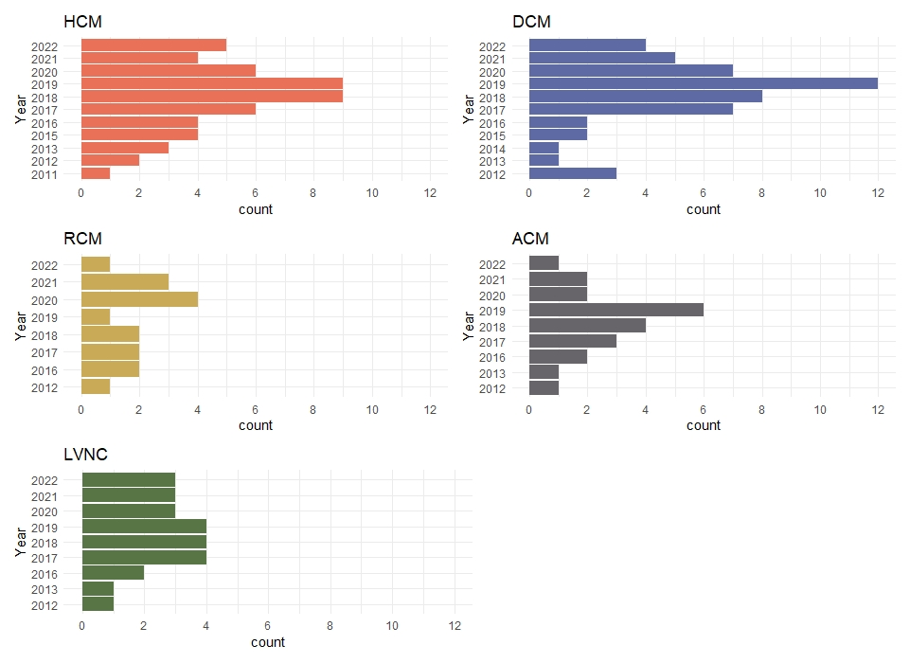
Supplementary Figure 2. Publications by Cardiomyopathy type and year.

Slide 8
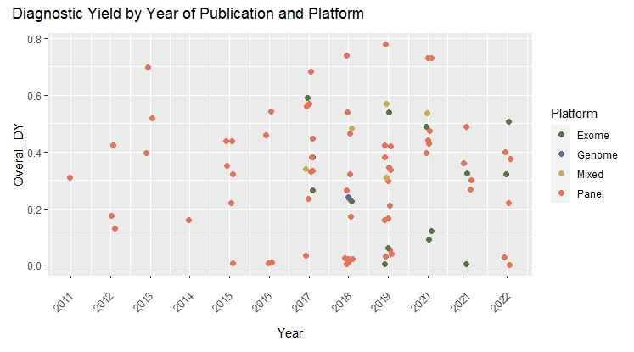
Supplementary Figure 5. Test platform and Diagnostic Yield

Slide 9
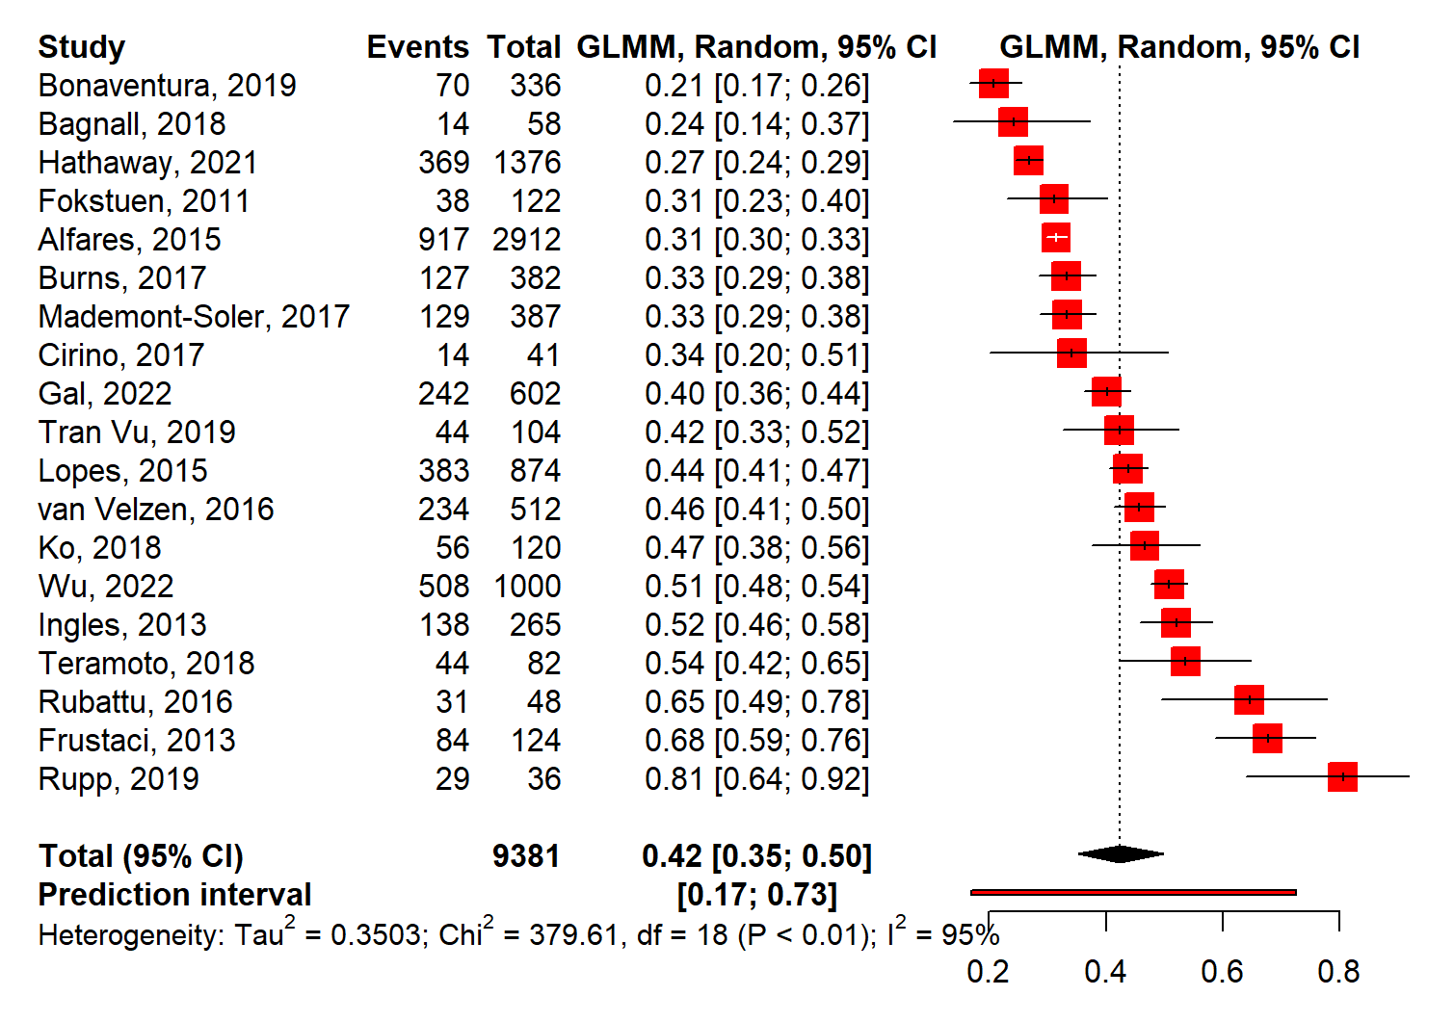
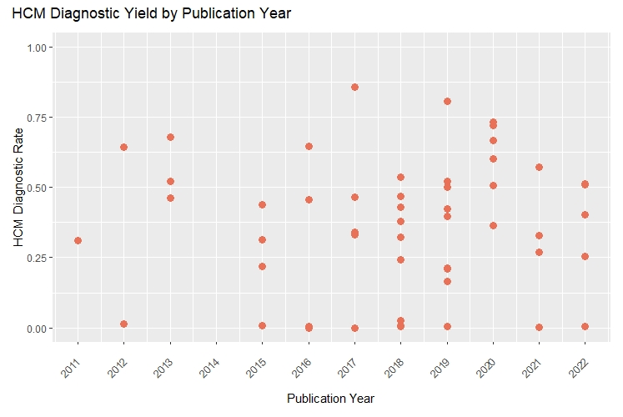
Subgroup Analyses
HCM Studies
Results for subgroups (random effects model):
 | k | proportion | 95%-CI
Children&Adults | 11 | 0.4277 | [0.3221; 0.5403]
Adults_only | 10 | 0.4739 | [0.4002; 0.5487]
Children_only | 9 | 0.5585 | [0.4487; 0.6630]
Unknown | 6 | 0.2784 | [0.1960; 0.3792]
Test for subgroup differences (random effects model):
 |  | Q | d.f. | p-value
Between groups |  | 23.09 | 3 | <0.0001
HCM Only Studies
Results for subgroups (random effects model):
 | k | proportion | 95%-CI | 95%-CI
Adults_only | 8 | 0.4766 | [0.3907;0.5640] | [0.3907;0.5640]
Children_only | 2 | 0.6089 | [0.0004;0.9998] | [0.0004;0.9998]
Unknown | 2 | 0.3274 | [0.1272;0.6192] | [0.1272;0.6192]
Children&Adults | 6 | 0.3835 | [0.2594;0.5249] | [0.2594;0.5249]
Test for subgroup differences (random effects model):
 | Q | d.f. |  | p-value
Between groups | 14.9 | 3 |  | 0.0019
Supplementary Figure 9. HCM Diagnostic Yield

Slide 10
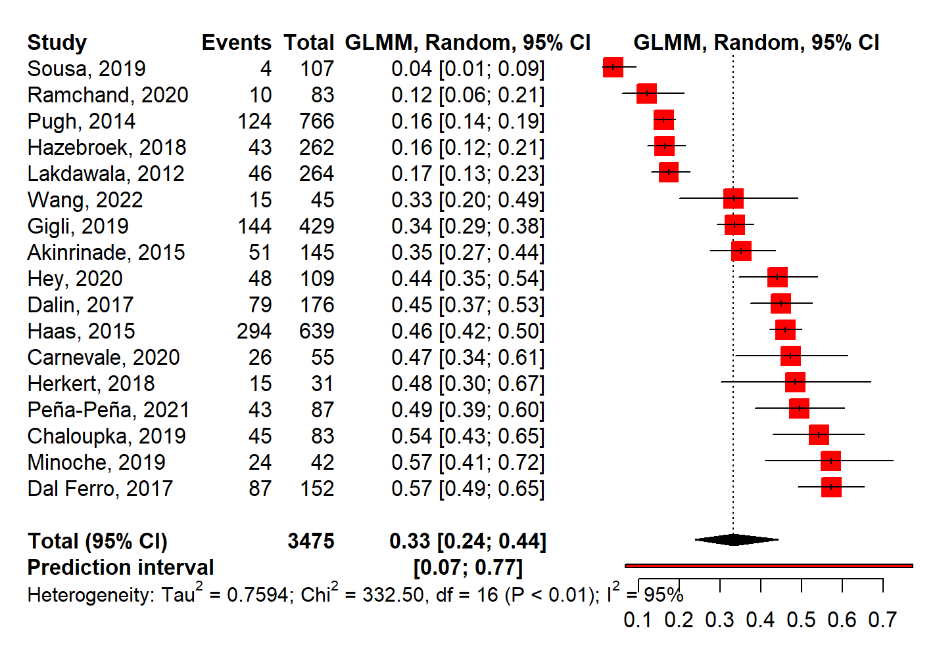
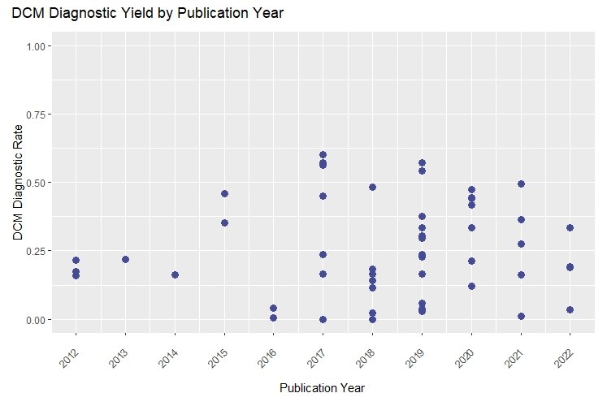
Supplementary Figure 10. DCM Diagnostic Yield

Slide 11
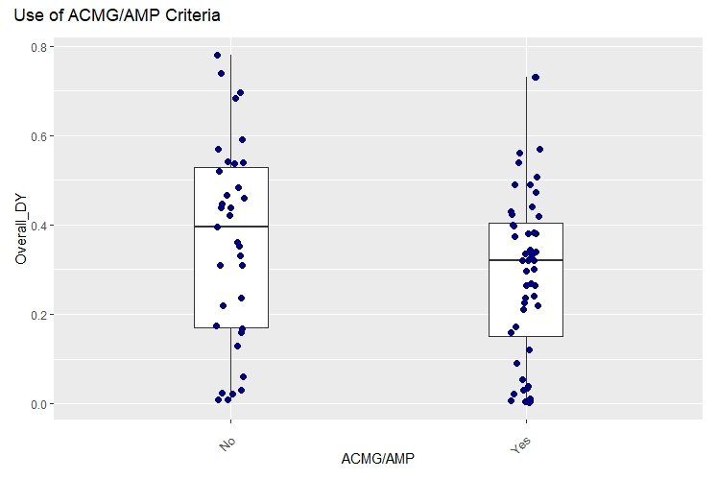
Supplementary Figure 7. Use of ACMG/AMP Variant Classification Criteria and Diagnostic Yield

Slide 12
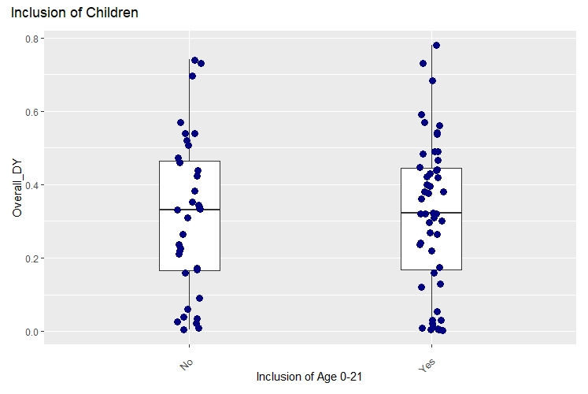
Age_groups | N= Publications
Children&Adults | 35
Adults_only | 26
Children_only | 16
Unknown | 10
Total | 87
Supplementary Table 2. Inclusion of Children
Supplementary Figure 8. Inclusion of Children and Diagnostic Yield

Slide 13
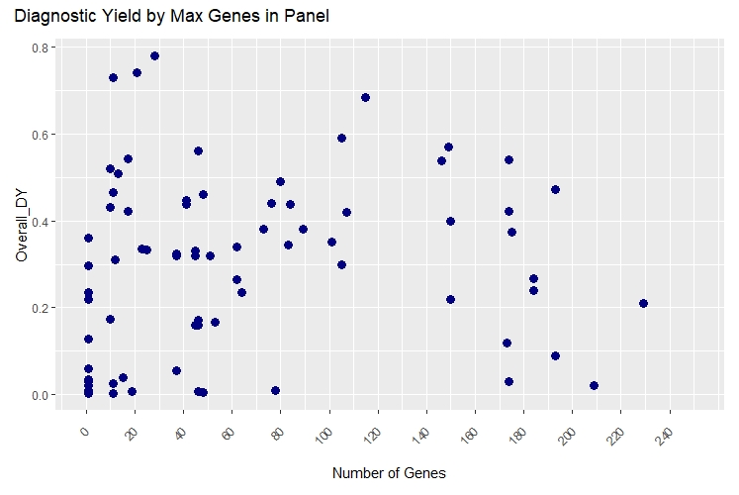
Supplementary Figure 6. Maximum Number of Genes in Panel and Diagnostic Yield

Slide 14
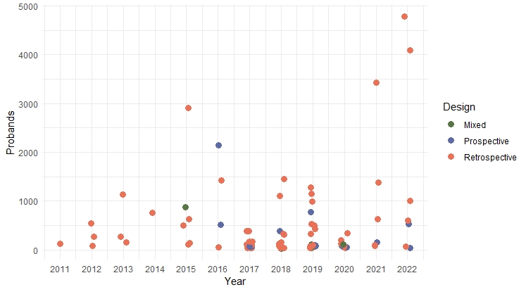
Design | N = Publications
Retrospective | 68
Prospective | 13
Mixed | 3
Total | 87
Supplementary Table 1. Study Designs
Supplementary Figure 3. Publications by year and study design.

Slide 15
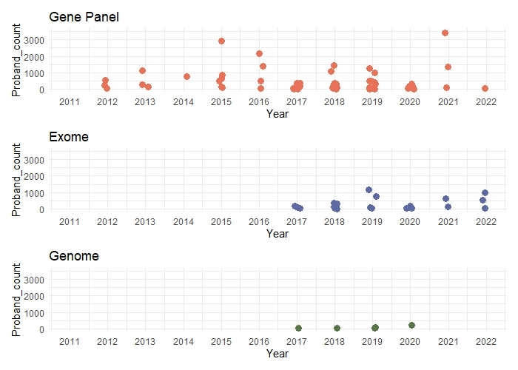
Supplementary Figure 4. Test platform and proband counts

Slide 16
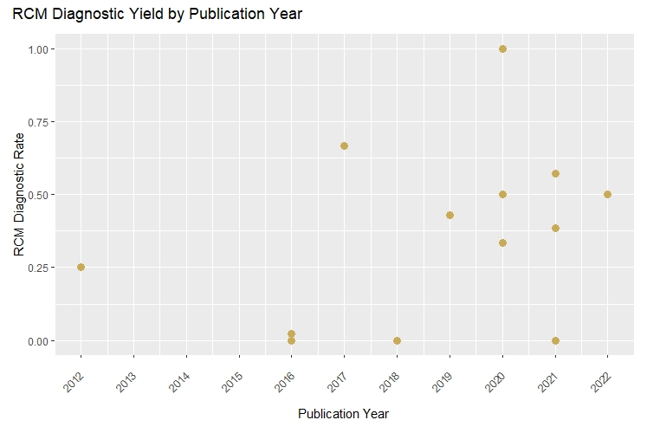
Supplementary Figure 11. RCM Diagnostic Yield

Slide 17
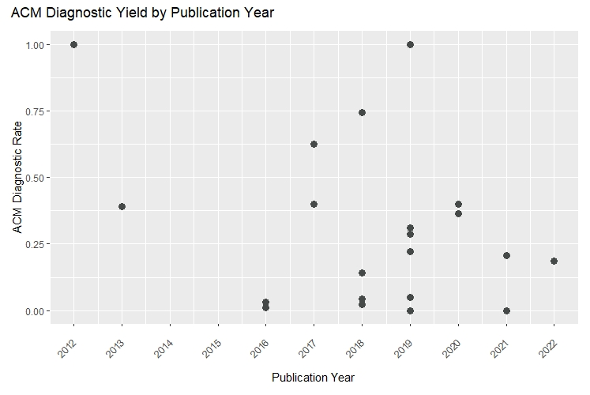
Supplementary Figure 12. ACM Diagnostic Yield

Slide 18
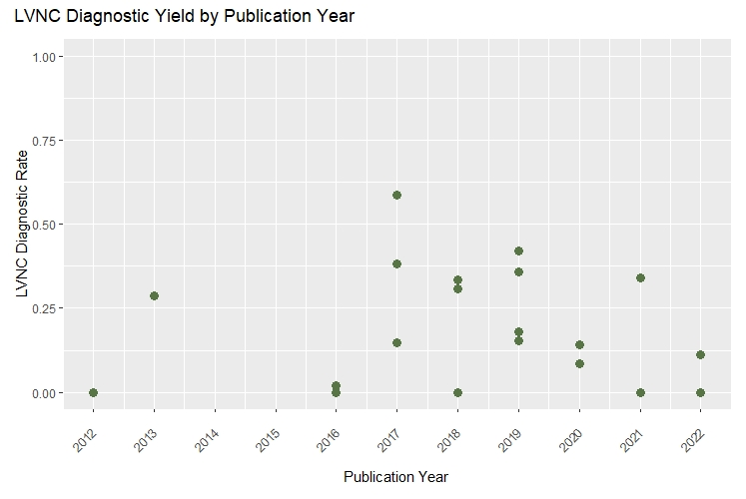
Supplementary Figure 13. LVNC Diagnostic Yield

Slide 19
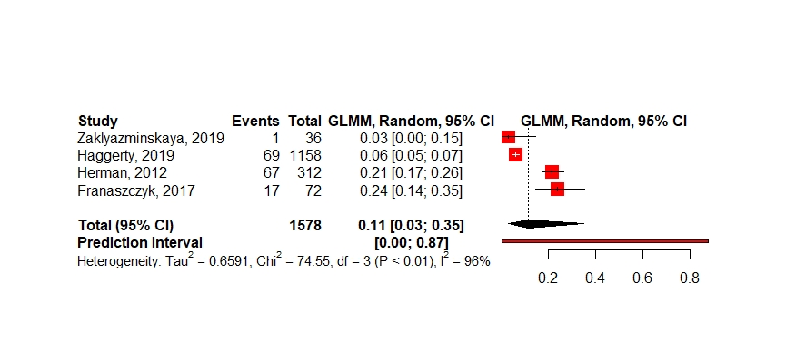
Supplementary Figure 14. DCM tested for TTNtv

